Slide 1



ZENLISH – HỌC TOEIC 1 LẦN LÀ ĐẠT
BEGINNER’S TOEIC
LESSON 1

Slide 2



ZENLISH – HỌC TOEIC 1 LẦN LÀ ĐẠT
BEGINNER’S TOEIC
LESSON 1
PART 1: LUYỆN ĐỀ TỔNG HỢP

Slide 3
GIỚI THIỆU
LÝ THUYẾT PART 1 LISTENING

Slide 4
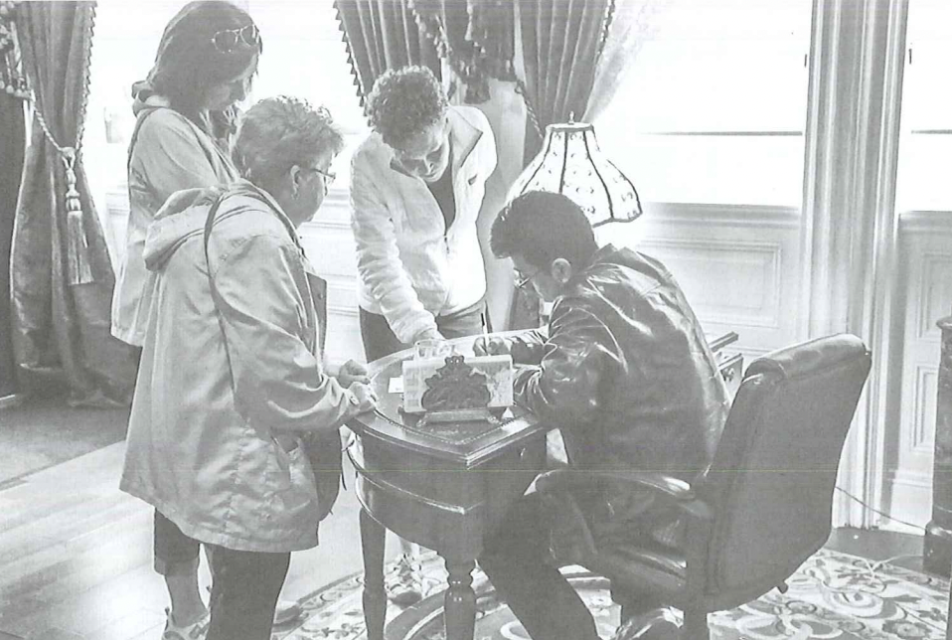
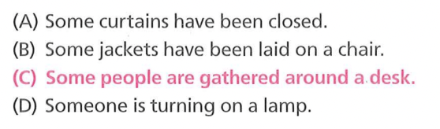
Part 1: Mô tả tranh (6 câu hỏi)

Slide 5
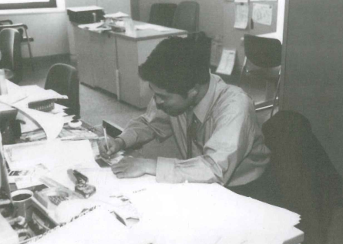
TRANH TẢ NGƯỜI
Dấu hiệu nhận biết: Thường con người sẽ chiếm tỷ lệ lớn trong bức tranh
4 yếu tố phân tích tranh tả người:
🙎🏻‍♂️ Chủ thể 🙎🏻‍♂️
✍🏻 Hành động ✍🏻
👔 Trang phục 👔
🌆 Bối cảnh 🌆

Slide 6
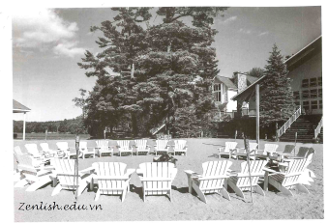
TRANH TẢ VẬT
Dấu hiệu nhận biết: Trong tranh tả vật sẽ không có người, chỉ có vật
❌ Loại các đáp án có chứa N chỉ người
❌ Loại các đáp án có chứa từ “being”
=> Cấu trúc câu bị động thì hiện tại tiếp diễn: S + tobe + being + Ved
❗️ Chú ý tới vị trí giữa các đồ vật với nhau

Slide 7

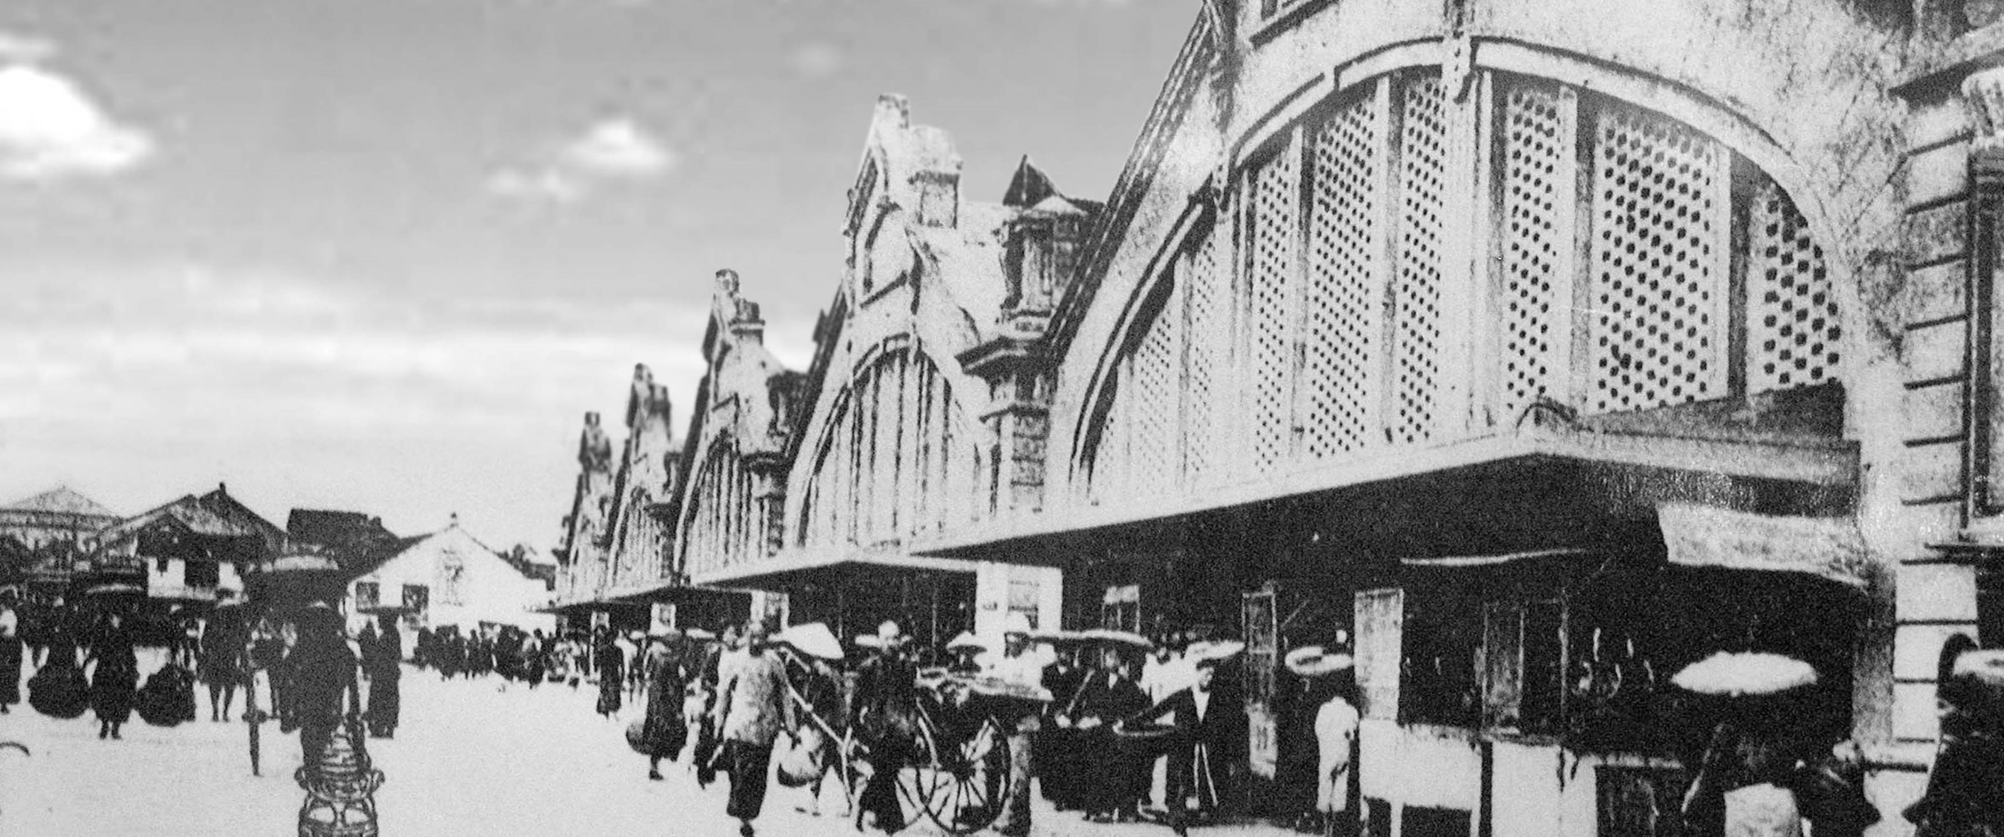
01
ACTUAL TEST 1
ZENLISH – HỌC TOEIC 1 LẦN LÀ ĐẠT

Slide 8

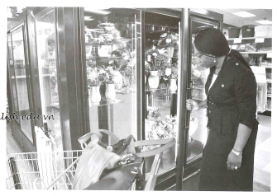

01

Slide 9
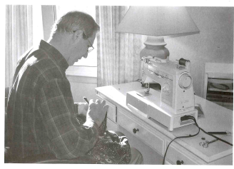
02

Slide 10
03

Slide 11
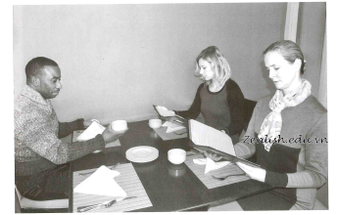
04

Slide 12
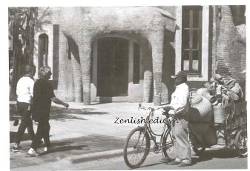
05

Slide 13
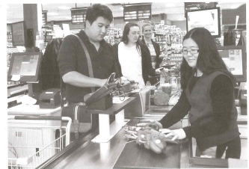
06

Slide 14

ACTUAL TEST 01
Tapescript & Anwser Key
1-B 4-A
2-C 5-B
3-A 6-D

Slide 15
01
She’s searching in her handbag
She’s looking in a display case
She’s paying for a purchase
She’s holding some flowers

Slide 16
02
The man is switching off a lamp
The man is opening some curtains
The man is seated by a window
The man’s hanging some photographs on the wall

Slide 17
03
Some chairs are arranged in a circle
Some stairs are being cleaned
A roof is being repaired
A tree is being trimmed

Slide 18
04
One of the women is wearing a scarf
The women are talking to each other
The man is pouring coffee into a cup
The people are closing their menus

Slide 19
05
A notice is being hung on a post
The women are walking toward a doorway
The man is changing a bicycle tire
A basket is being removed from a cart

Slide 20
06
A shop assistant is giving a man some money
Some people are entering a supermarket
A cashier is putting merchandise into a bag
Some customers are waiting in line

Slide 21
01
ACTUAL TEST 2
ZENLISH – HỌC TOEIC 1 LẦN LÀ ĐẠT

Slide 22
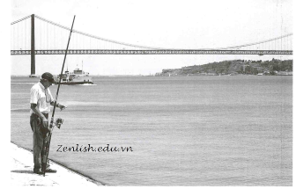
01

Slide 23
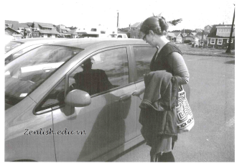
02

Slide 24
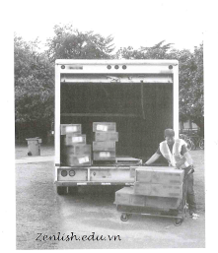
03

Slide 25
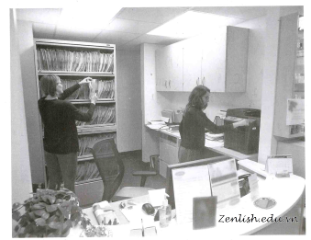
04

Slide 26
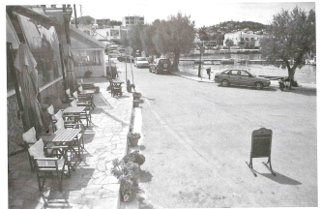
05

Slide 27
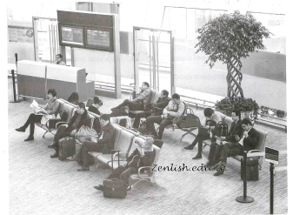
06

Slide 28
ACTUAL TEST 02
Tapescript & Anwser Key
1-C 4-B
2-C 5-D
3-B 6-A

Slide 29
01
He’s walking along the shore
He’s swimming in the sea
He’s holding a fishing pole
He’s getting into a boat

Slide 30
02
A woman’s standing on a busy street
A woman’s wiping a car window with a cloth
A woman’s carrying a jacket over her arm
A woman’s parking a vehicle

Slide 31
03
A truck has stopped at a traffic light
A man is loading boxes onto a cart
A man is kneeling on the grass
Some boxes are stacked on the ground

Slide 32
04
One of the women is writing on a notepad
One of the women is looking at some files
The women are sitting at their desks
The women are facing each other

Slide 33
05
Cars are parked in a garage
Plants are arranged on tables
There are umbrellas blocking a road
There are chairs set up in front of a building

Slide 34
06
Some travelers are seated in a waiting area
Some workers are setting up partitions
One of the women is handing out tickets
One of the men is approaching a counter

Slide 35
01
ACTUAL TEST 3
ZENLISH – HỌC TOEIC 1 LẦN LÀ ĐẠT

Slide 36
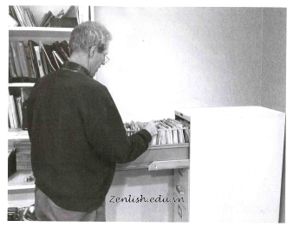
01

Slide 37
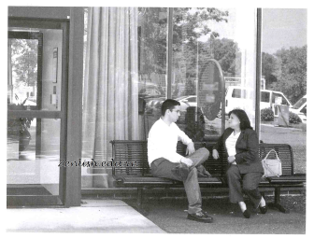
02

Slide 38
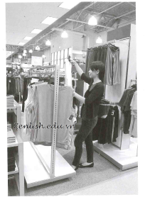
03

Slide 39
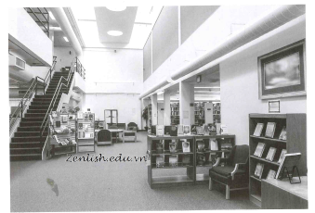
04

Slide 40
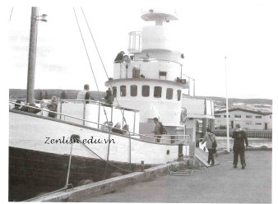
05

Slide 41
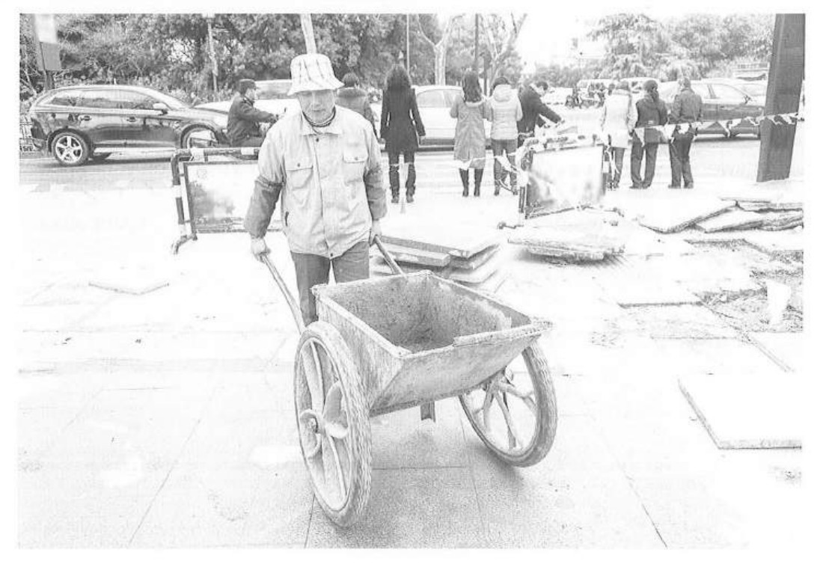
06

Slide 42
ACTUAL TEST 3
Tapescript & Anwser Key
1-A 4-B
2-B 5-C
3-A 6-D

Slide 43
01
He’s looking in a file drawer
He’s printing some documents
He’s stacking some folders
He’s putting on his glasses

Slide 44
02
Some people are sitting in a car
Some people are facing each other
A woman is opening her handbag
A man is removing his jacket

Slide 45
03
Clothing is hanging on racks
Lights have been turned off in the store
A woman is folding a coat
A woman is opening a garment bag

Slide 46
04
Some armchairs are occupied
Books and magazines have been arranged on shelves
A gate has been placed at the bottom of a stairway
A painting has been left on the floor

Slide 47
05
A flag is being raised on a pole
A ship is approaching a pier
Some people are walking toward a boat
Some workers are sweeping a dock

Slide 48
06
A man is putting up a metal barrier
Some people are boarding a bus
A cart is being loaded with bricks
A wheelbarrow is being pushed at a work site

Slide 49
THANK YOU

